Slide 1

SOL & SOMBRA
A responsive sunglasses e-commerce website
HTML · CSS · JavaScript (DOM manipulation only)
CPU4104-20C Web Development — Summative Assessment (S1)
Juan Carlos Madrid · Student ID G271958 · Global Banking School
Notes:
(~40 sec) Hello, my name is Juan Carlos Madrid, student ID G271958. This is my summative project for CPU4104 Web Development: Sol and Sombra, a responsive e-commerce website for a Mediterranean sunglasses shop. It is built entirely with HTML, CSS and vanilla JavaScript using DOM manipulation only - no frameworks, no libraries, no backend, exactly as the brief requires. In the next ten minutes I will walk through the site, the code structure, and the reasoning behind my main design decisions.

Slide 2
THE BRIEF
Scenario & theme choice
Scenario: a small retail business needs an online presence to browse products, view details and manage a basket.
Chosen theme: Fashion accessories — a specialised sunglasses store.
Why sunglasses: strong visual products, natural categories for filtering, and a coherent brand story (Mediterranean coast).
Constraint respected: front-end only. No React, Vue, jQuery, Bootstrap — every line is my own HTML, CSS and JS.
5
25
pages
products
0
3
libraries
breakpoints
2
Notes:
(~45 sec) The brief asks for a front-end solution for a small retailer: customers browse products, view details and manage a shopping basket. I chose a specialised sunglasses store. I picked this theme for three reasons: the products are highly visual which makes the design work meaningful; they split naturally into categories which gives my filter feature a purpose; and it let me build a coherent brand, Sol and Sombra, inspired by the Mediterranean coast. The headline numbers: five pages, twenty-five products including a new-season drop, three responsive breakpoints, and zero external libraries - everything is hand-written.

Slide 3
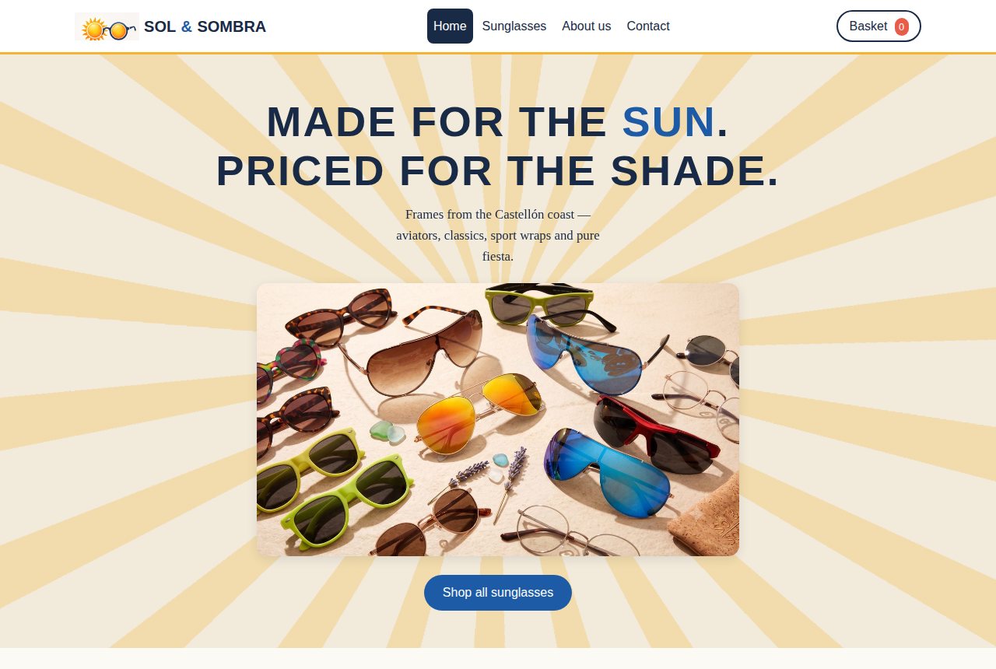
THE WEBSITE
Five pages, one consistent brand
index.html — hero banner, an original short brand video with a self-composed soundtrack, featured products, three collection sections.
products.html — 25 product cards with live category filters, including a New Season badge.
cart.html — quantities, removal and a dynamically calculated total.
about.html & contact.html — brand story, FAQ and a validated contact form.
Persistent header: custom logo, navigation and a live basket counter on every page.
3
Notes:
(~50 sec) Here is the home page. The site has five pages sharing one header and footer, with my own logo built into every page. The home page opens with a hero banner and, further down, a short brand video I generated myself - twenty-five frames set to an original guitar soundtrack I composed and synthesised in code, so there are no copyright concerns anywhere in the project. Below that sit the featured products and three collection sections. The products page holds all twenty-five frames, including a New Season badge on the latest nine. The animated sun behind the hero is drawn in pure CSS with a repeating conic gradient - no image, which I will come back to.

Slide 4
LO1 · HTML
Semantic structure, not divs
<header> <nav>
Site identity and navigation, with aria-current marking the active page
<main> <section>
One <main> per page; sections labelled with aria-labelledby headings
<article>
Each product card is a self-contained article
<figure> <figcaption>
Collection images carry visible captions
<footer> <address>
Contact details in the semantically correct element
4
Notes:
(~45 sec) For learning outcome one, my HTML is semantic rather than div-based. Every page uses header, nav, main and footer landmarks. Each product card is an article element because it is self-contained content. Collection images use figure and figcaption. The contact details sit in an address element. The navigation marks the current page with aria-current, which both styles the active link through an attribute selector and announces it to screen readers. There is no deprecated HTML and no HTML used for presentation - all styling lives in the CSS.

Slide 5
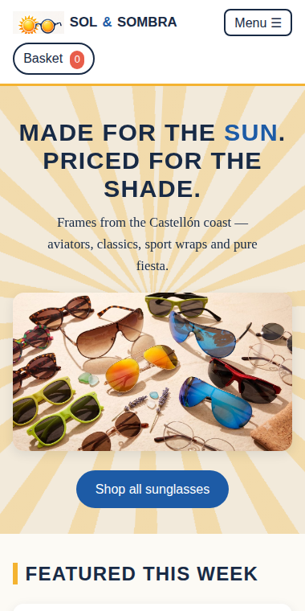
LO3 · CSS
Mobile-first responsive design
Base styles target mobile; two min-width media queries enhance upward: 600px (tablet) and 900px (desktop).
Product grid: 1 column on phones, 2 on tablet, 4 on desktop — CSS Grid with a single rule change per breakpoint.
Collapsible menu on small screens (JS toggles a class; CSS does the rest).
Fluid type with clamp() on the hero; flexible images with max-width and height:auto.
Selector range: element, class, ID, :hover, :focus-visible, :nth-of-type, ::before, ::marker, [aria-current], [type=email].
5
Notes:
(~50 sec) The CSS follows the mobile-first paradigm the brief requires. All base styles are written for small screens, then two min-width media queries at 600 and 900 pixels enhance the layout for tablet and desktop. The clearest example is the product grid: one column on phones, two on tablets, four on desktop - and because it uses CSS Grid, each breakpoint changes a single line. On mobile the navigation collapses into a menu button, and the header itself wraps gracefully down to very narrow phones. I also demonstrate the full range of selector techniques the brief lists: element, class and ID selectors, pseudo-classes like hover and focus-visible, pseudo-elements, and attribute selectors such as aria-current for the active page.

Slide 6
DESIGN DECISIONS
A brand, not a template
Cal white
Ink navy
Azulejo blue
Sun gold
Sunset coral
#FCFAF5
#182A45
#1D5BA6
#F4B331
#E85D4A
All colours stored once as CSS custom properties (design tokens) — one change re-themes the whole site.
Custom logo (sun + round frames) built into the header on every page, and as a full brand card on About.
Signature element: the hero sun, drawn with repeating-conic-gradient and animated with a keyframe rotation — zero image weight.
Every asset is original or self-generated, including a synthesised soundtrack for the collection video — no third-party or copyrighted material anywhere.
6
Notes:
(~50 sec) These five colours are the whole brand: whitewash, ink navy, azulejo blue, sun gold and sunset coral - a palette taken from the Spanish Mediterranean. They are defined once as CSS custom properties, so changing the brand means editing one block at the top of the stylesheet. My logo, a sun wearing round sunglasses, sits in the header of every page. My signature design element is the sun behind the hero: it is not an image but a repeating conic gradient rotated by a CSS animation, so it costs zero bytes of image weight. And to keep the whole project free of licensing concerns, every asset is either my own edited photography or fully self-generated - including the guitar soundtrack behind the collection video, which I synthesised programmatically rather than sourcing from anywhere.

Slide 7
LO2 · JAVASCRIPT
The basket: data flows, DOM follows
HTML data-*
localStorage
DOM render
→
→
Each Add button carries id, name, price, image
One JSON array survives page navigation
cart.html table, totals & badge rebuilt from data
Add, remove, increase/decrease quantity, live total — all via DOM manipulation, as required.
Event delegation: one click listener on the document serves every button, read through data-action / data-id.
HTML is the single source of truth — adding a product means adding one <article>; no JavaScript changes needed.
7
Notes:
(~55 sec) Now the JavaScript, learning outcome two. The basket follows a simple pipeline. First, every Add to Basket button carries its product data in HTML data attributes: id, name, price and image path. When clicked, the script reads those attributes and stores the item in a JSON array in localStorage - which is what lets the basket survive as the customer moves between separate pages. Finally, the basket page and the header badge are rebuilt from that stored data using DOM manipulation. Two decisions worth justifying: I use event delegation, a single click listener on the document that identifies buttons through their data-action attribute - fewer listeners, and it works for elements created after page load. And by keeping product data in the HTML rather than a JavaScript array, the HTML is the single source of truth: adding product twenty-six means adding one article block, with no script changes.

Slide 8
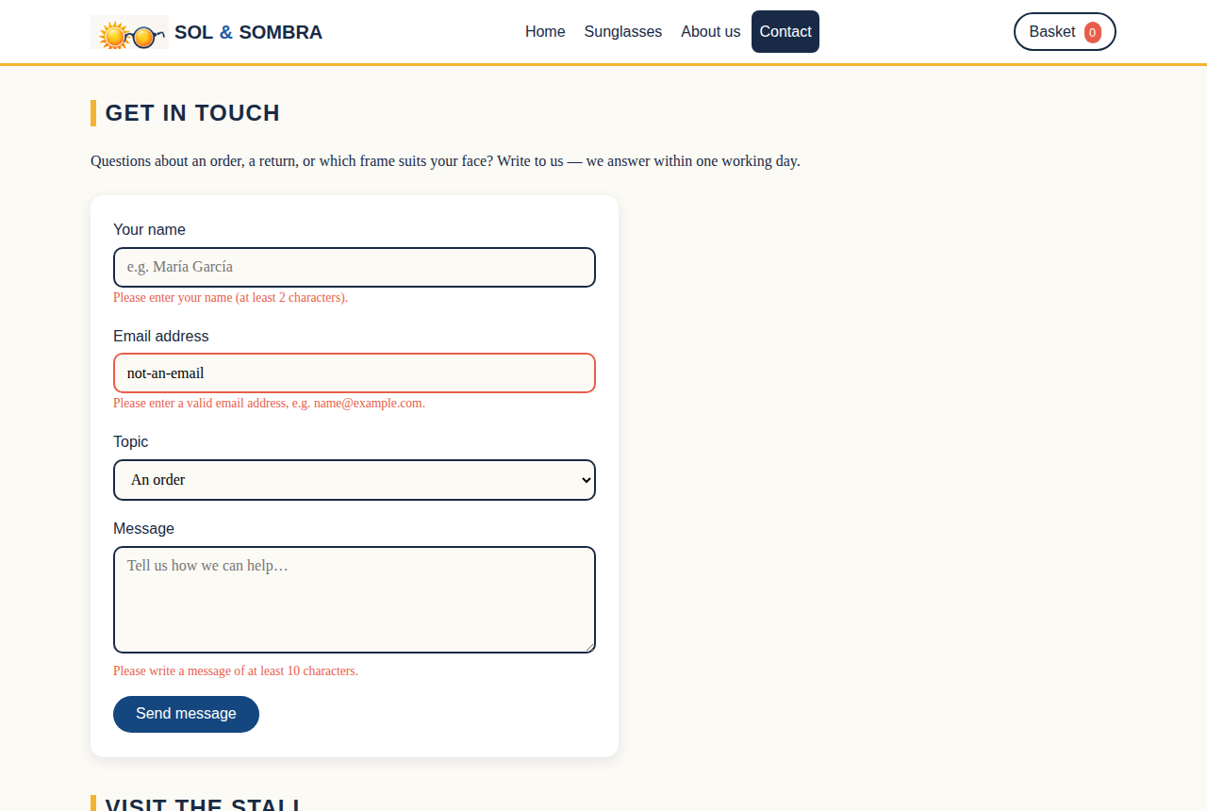
LO2 · JAVASCRIPT
Filters & form validation
Category filters compare each card's data-category and toggle visibility — ~12 lines of JS enhancing static HTML.
Contact form: custom validation for name length, email pattern (regex) and message length.
Errors appear inline next to each field in aria-live regions, so screen readers announce them.
Valid submission shows a success state and resets the form.
8
Notes:
(~40 sec) Two more JavaScript features. The category filters enhance the static product grid: clicking Aviator compares each card's data-category attribute and hides the rest - about twelve lines of code. And the contact form has custom validation, shown here: the name must be at least two characters, the email is checked against a regular expression, and the message needs at least ten characters. Errors appear inline next to each field inside aria-live regions, which means screen readers announce them as they appear - validation that is also accessible.

Slide 9
LO3 & LO4 · ACCESSIBILITY
WCAG principles + Lighthouse evidence
Alt text on every image; descriptive, not decorative
Skip-to-content link for keyboard users
Visible :focus-visible outlines on all interactive elements
ARIA: labels on icon buttons, aria-live basket, aria-expanded menu
Colour contrast checked against the navy/white palette
prefers-reduced-motion support
Lighthouse audit workflow: audit → screenshot (Problem1/2.png) → fix (label-in-name, heading order) → re-audit → screenshot (Fix1/2.png) → saved in /evidence. Accessibility now scores 100 across all five pages.
9
Notes:
(~50 sec) Accessibility was designed in, not added at the end. Every image has descriptive alt text. Keyboard users get a skip-to-content link and visible focus outlines. ARIA attributes label the icon buttons, make the basket a live region, and report the mobile menu state. Colour contrast was checked for the navy-on-white palette, and animation respects prefers-reduced-motion. For evidence, I followed the workflow the brief specifies: I ran a Chrome Lighthouse audit, found two real issues - button accessible names not matching their visible text, and a skipped heading level - screenshotted them as my Problem evidence, fixed both, and re-audited. All five pages now score one hundred on Accessibility. [SHOW YOUR ACTUAL LIGHTHOUSE SCREENSHOTS ON SCREEN AT THIS POINT.]

Slide 10
LO4 · SEO & DEPLOYMENT
Findable, shareable, and live
Unique <title> per page
Meta descriptions & Open Graph
Five distinct titles, not one repeated across the site
Hand-written summaries and correct social preview image
Heading hierarchy
Optimised images
Exactly one h1 per page, ordered h2/h3 beneath it
Web-scaled files, lazy loading below the fold
Deployed on GitHub Pages
Code hosted in a public GitHub repository; the live site is served over real HTTP, which is what makes the Lighthouse audit and the collection video work exactly as they will for the marker.
10
Notes:
(~45 sec) For SEO, every page has a unique title and a hand-written meta description for its search snippet, plus Open Graph tags for social sharing. Each page has exactly one h1 with an ordered heading hierarchy, and product images are scaled for the web and lazy-loaded below the fold. For deployment, the project is hosted in a public GitHub repository with the folder structure the brief specifies, and published live through GitHub Pages. That matters practically too: features like the Lighthouse audit and the video element only behave correctly over real HTTP, not when opened as a local file - so the live GitHub Pages link is also my proof that everything works outside my own machine.

Slide 11
REFLECTION
What I learned & what I'd build next
What I learned
Next iteration
Mobile-first genuinely simplifies CSS — desktop became the enhancement, not the battle.
Event delegation beats per-button listeners for maintainability.
Accessibility is cheapest when designed in from the first line.
Product detail views with size guides and lens specs.
A checkout form with full validation (the pattern already exists in contact.html).
Search box alongside the category filters.
11
Notes:
(~35 sec) Briefly, what this project taught me. Mobile-first turned out to genuinely simplify the CSS - the desktop version became a small enhancement rather than a fight. Event delegation made the JavaScript shorter and easier to maintain than one listener per button. And accessibility proved cheapest when considered from the first line rather than retrofitted. If I iterated, I would add richer product detail views, a validated checkout form reusing the contact form's pattern, and a search box beside the filters.

Slide 12
Learning outcomes, delivered
LO1
Web pages built with valid, semantic HTML & hand-written CSS
LO2
Client-side scripting: basket, filters, validation — DOM only
LO3
Mobile-first responsive layouts across three breakpoints
LO4
Accessibility, UX, SEO, GitHub Pages deployment & audited best practices
Gracias — thank you for watching.
Notes:
(~30 sec) To close: learning outcome one is met with valid semantic HTML and hand-written CSS; outcome two with the basket, filters and validation built purely through DOM manipulation; outcome three with a mobile-first layout across three breakpoints; and outcome four with accessibility, SEO, GitHub Pages deployment and the Lighthouse-audited improvements in my evidence folder. The full code is live on GitHub. Gracias - thank you for watching.

